Slide 1
Gimp 101
Tools

Slide 2
Gimp Workspace
Open Gimp
What windows do you see?
There are two main windows we need to have open:
Toolbox: Where all the GIMP’s tools are kept.
Image Windows: Where the images we are editing will be.
Metaphor: Like an artist’s desk!
Activity
Drag windows around to adjust them to your liking.
Activity: To view available windows or to open a window you’ve accidentally closed.
Click on Windows.
Click on dockable dialogs.
Click on (layers, toolbox, etc.) to open up a window.

Slide 3
Opening Images
Go to www.becktastic.weebly.com
CAEM -> Right click on the three NY photos and save images.
Go to Gimp
Activity: Open an image
Click on file.
Navigate to the NY image of a Rockefeller St. Sign
Open file.
All of our file actions – opening, closing, saving, printing, etc. – are done with the menus at the top of the Image Window.

Slide 4
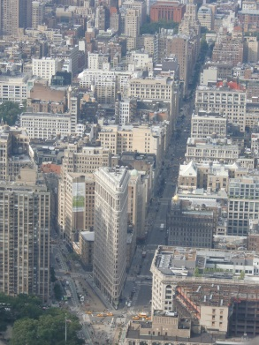
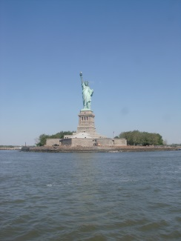
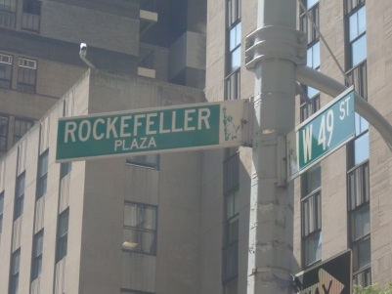
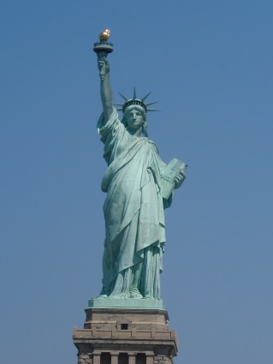
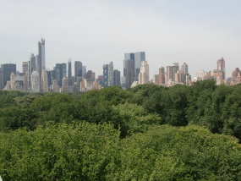
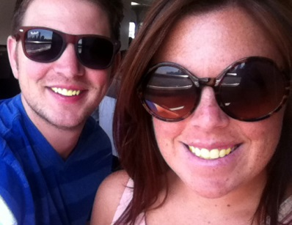
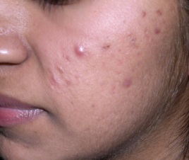
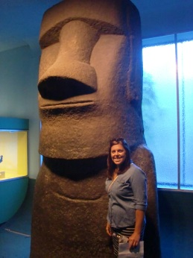
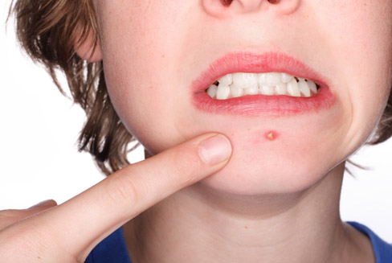
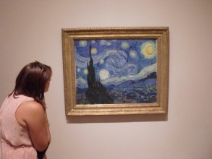

Slide 5
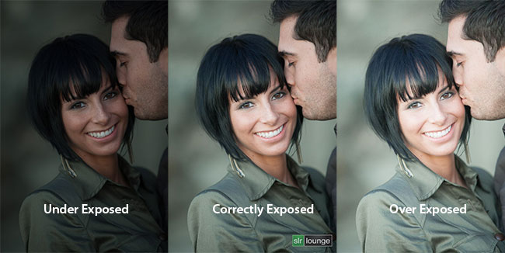
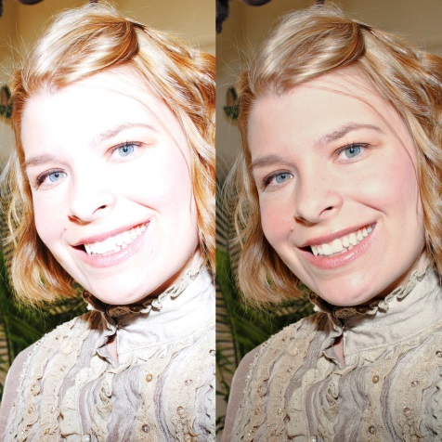
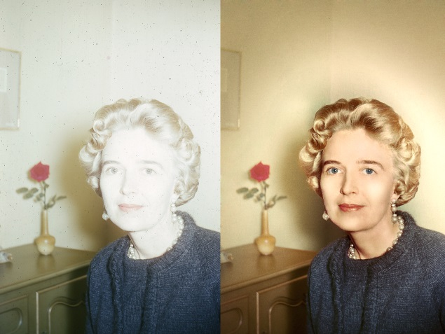
Over Exposed Images

Slide 6
Exposure Correction
The Street Sign picture we just opened is “over exposed”, meaning there’s too much light. “Exposure” refers to how much light is in a picture.
Activity: Correcting the exposure.
Click on color tab at top of window.
Click on brightness-contrast level tool.
Brightness – is how much light is in the picture – full brightness is all white, no brightness all black.
Contrast – is how stark the difference between white and black – full contrast gets you weird fever dream Technicolor, and no contrast is all grey.
Adjust sliders for brightness and contrast.
Activity: Adjusting both contrast and brightness simultaneously with levels.
Click on colors.
Click on levels.
Adjusting sliders will adjust both contrast and brightness at the same time.
Notes:
Teachers tip: Point out that “reset” puts things back at their starting values, cancel will remove changes, and OK will finalize changes.
Adjusting Levels:Teachers Tip: This tool gives you a map of all the black, white, and grey in the picture, letting you adjust their intensity and proportion.

Slide 7
Color Correction
Explanation
Once we’ve corrected our exposure we can look at colors. There are two main vocabulary terms we need to know for this:
Hue: A fancy word for color – where in the visible spectrum a color is located.
Saturation: intensity of a color, how vibrant it is. Low saturation is grey, high saturation becomes fluorescent.
Activity: Adjust the hue-saturation of the photo.
Click on colors.
Click on Hue-Saturation.
Notes:
Teachers Tip: You can also colorize or tint a picture by clicking on colors and then using the colorize tool.

Slide 8
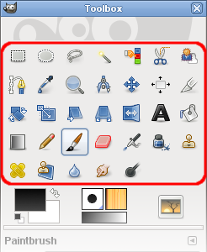
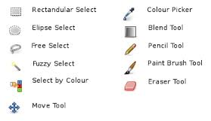
Correcting Part of a Photo
Explanation
What if we want to change just one part of a picture?
The first six icons in our toolbar are our selections tools. You have:
Rectangle select
Ellipse select
Free select (free hand drawing of a selection)
Fuzzy select (selects a contiguous area by color)
Select by color (selects all the areas of a specific color)
Scissors select (tries to detect edges in image)

Slide 9
Correcting Part of a Photo
Activity: Selecting an area with the rectangular tool.
Click on the rectangle select tool in the tool box.
Draw a selection rectangle around a portion of the image.
When you select something in GIMP, the area will be surrounded by “crawling ants” – a moving border.
Add to the selection by using shift and drawing another rectangle.
This works with every selection tool.
Activity: change the color by using the “Color” tab at the top.
Play with multiple changes

Slide 10
Correcting Part of a Photo
Open new image
Statue of Liberty
Activity: Selecting only the sky in the “Statue of Liberty” image.
Select fuzzy select tool in toolbox.
When things are mostly the same color we use the fuzzy select tool.
Select the sky. Hold shift to add sections until the sky is covered in crawling ants.
With the sky selected use the hue-saturation menu and level menu to deepen the blue in the sky.

Slide 11
Correcting Part of a Photo
Practice: Open up the “yellow teeth” file. We can use the same technique here- selecting an area and adjusting color – to do things like whiten teeth and remove red eye in photos. Use the fuzzy select tool and hue-saturation menu to whiten the woman’s teeth.

Slide 12
Taking out part of the image
Open image
In the layer tab on, right click on the image layer-> select “Add Alpha Channel,” near the bottom.
Use the rectangle, ellipse, free select, or fuzzy select tool to select a part of the image you want to remove.
When the area or part of the area is selected then click the “delete” key on your keyboard. This will remove the part of the image that was selected, leaving behind a transparent (or see through) film on that part of the image.

Slide 13
Cropping
Explanation
Occasionally you’ll have photos you want just a part of.
For instance, you don’t want to get too close to a moose while taking a photo, but you’d like to be able to show the photo to people and have them see just the moose – not all this greenery.
Activity: Cropping out just the Statue of Liberty.
Open Stature of Liberty Image from a distance
Select the crop tool from the tool box.
Draw a box over just the moose.
Click in the center of the section you wish to crop.

Slide 14
Cropping part II
Explanation
If you want to be able to print this image correctly, we need to keep the aspect ratio (the relationship between the height and width of the picture) the same as photo paper.
Activity: Undo cropping and re-crop with consideration for aspect ratio.
Undo initial crop (either under the edit menu, or by pressing Ctrl + Z).
Select crop.
Select “fixed” aspect ratio in the tool options (NOTE: if this menu isn’t open, it can be found in windows->dockable dialogues->tool options).
Draw a rectangle around the Statue of Liberty – selection will maintain aspect ratio no matter what size you make it.

Slide 15
Photo Resizing
Explanation
If you ever need to resize a photo, it’s easily enough done – you just need to know a few basic things.
First, if you’re printing (and it is staying the same aspect ratio), you don’t need to resize a photo – the printer can scale an image for you. Resizing is usually only necessary if you’re combining images or putting images on a website.
Secondly, you can only get pictures so large before they start to look bad.
Pictures are made of pixels – tiny squares of color. Have class zoom into the current picture until they can see individual pixels. Compare to pointillist painting.
How many pixels you have per inch is called the resolution. The more pixels, the bigger you can blow up a picture without losing quality.
So you have to think about three things when resizing: the height, width, and resolution.
Practice: Open any photo. Go to image->Scale image. Show how to change units on size and resolution, use chain icon to lock and unlock aspect ratio.

Slide 16
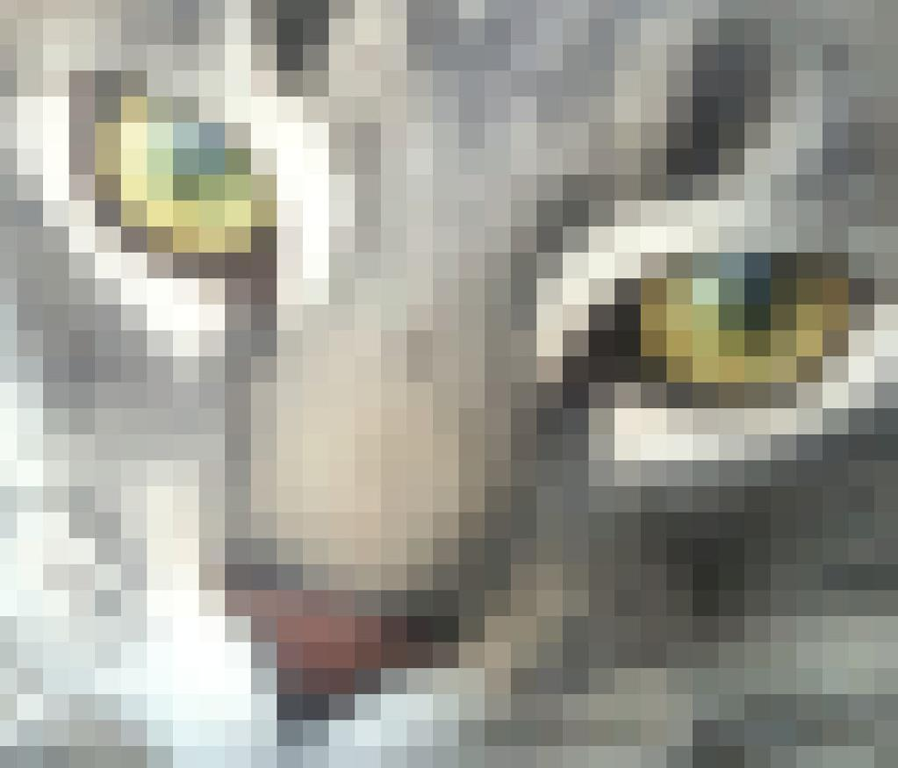
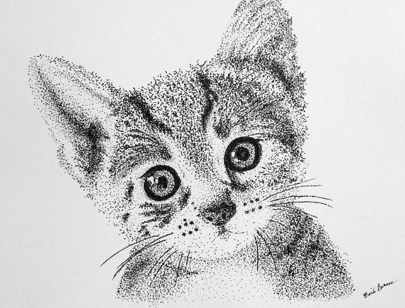
Pixilated
Pointillism

Slide 17
Fixing Blemishes
Explanation
Some corrections aren’t just for color or size – sometimes you have a pimple you’d really like to get rid of, or something similar.
Activity: Remove blemishes from “blemish_example.jpg”.
Click on healing tool in tool box.
Ctrl + click on clear skin.
Click on blemished skin to “erase” it.

Slide 18
Remove People
Explanation
You can also use a similar technique to remove unwanted people or things from pictures.
Activity: Open up “Tum-Tum” and erase human in picture.
Open up photo “Tum-Tum”.
Select clone stamp tool in tool box.
We’re going to erase the woman in the picture.
Ctrl + click on an area next to the woman to sample it.
Metaphor: imagine we’re painting over the woman – the ctrl + click is like we’re taking paint from a palette, and we then normal click to apply that paint where we want. To really hide the woman, we want the colors to match the beach around her – which means we have to keep taking our “paint” from different parts of the photo.
Click over the woman to paste the area you’ve sampled onto her.
Erase the woman.
Notes:
Teachers Tip: The class should be aware that they should sample liberally from the area around the woman to make it look more realistic (especially at the water line).

