Slide 1
Color Psychology

Slide 2
RED
Excitement
Strength
Passion
Speed
Danger

Slide 3
RED
Red also makes you hungry…

Slide 4
ORANGE
Playfulness
Warmth
Vibrant

Slide 5
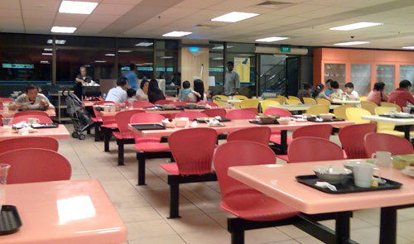
ORANGE
Orange also makes people want to hurry…

Slide 6
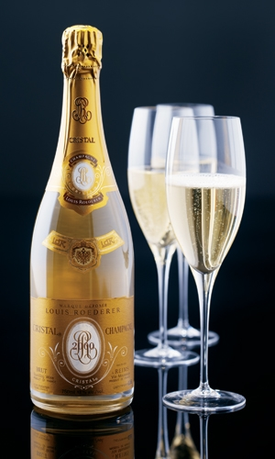
GOLD
Prestige
Expensive

Slide 7
YELLOW
Warmth
Sunshine
Cheer
Happiness

Slide 8
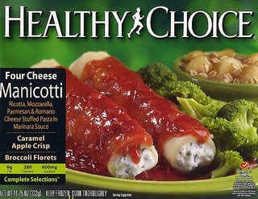
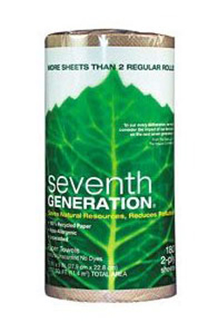
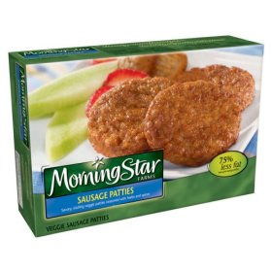
GREEN
Nature
Fresh
Cool
Growth
Abundance
Health

Slide 9
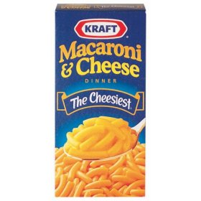
BLUE
Trust
Reliability
Belonging

Slide 10
PURPLE
Royal
Spirituality
Dignity

Slide 11
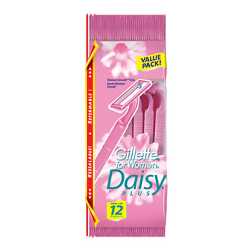
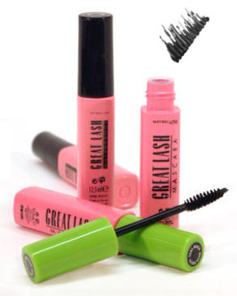
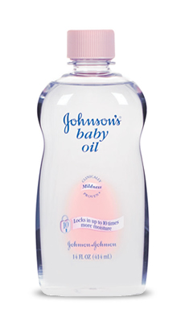
PINK
Soft
Sweet
Nurture
Security

Slide 12
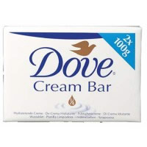
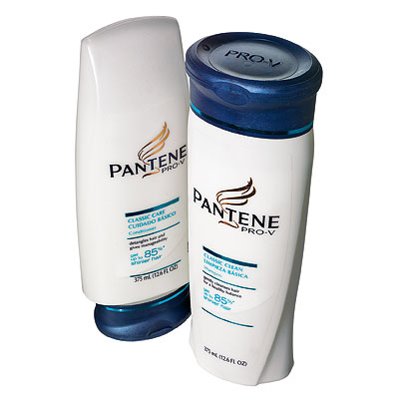
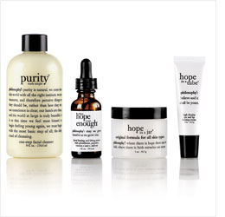
WHITE
Pure
Clean
Youthful
Mild

Slide 13
BLACK
Sophisticated
Elegant
Seductive
Mystery

Slide 14
SILVER
Prestige
Cold
Scientific

